Slide 1

Resources and ideas for a fruitful pastoral work
Welcome!

Slide 2

Initial Prayer
Notes:
Jim

Slide 3
The Purpose of This Workshop
Resources and ideas for a more
fruitful pastoral work
Revisit the intrinsic value of each step in the pastoral process for fruitful results in the community.
Identify the value of parish data, as a reflection of the energy dedicated in the parish towards certain topics.
Insist on the importance Spirituality of Communion in our parish and pastoral council.
Notes:
Jim

Slide 4
Contents
Introduction
7 Steps for Pastoral Planning
Pastoral Snapshot
Spirituality of Communion
09:05

Slide 5

Let us start with a theological reflection
John 15; 5-17
Notes:
Jim

Slide 6

Practicing Lectio Divina
Individual exercise
  Lectio: What does the passage say?
  Meditatio: What does this passage say to me?
  Oratio: What am I inspired to say back to God?
  Contemplatio: Experience God in my heart.
  Actio: What actions will I take?
In group
  Share your thoughts
  Group conversation
10 minutes
Notes:
Jim

Slide 7
Contents
Introduction
7 Steps for Pastoral Planning
Pastoral Snapshot
Spirituality of Communion
Facilitation Resources
09:20

Slide 8
7-Steps for Pastoral Planning
Notes:
Ricardo

Slide 9
Process Review
Let us review the process, using our handouts
Reinvigorate your PPC
Formalize your pastoral planning
Begin every meeting with prayer
Select objectives by consensus
Form Team
Align collaboration
Spirituality of communion
Spiritual priorities
Define action plan for each objective
Document your plans
Review, approve and activate
Leaders and resources
Plan defined
Plan activated
Notes:
Jim

Slide 10
Where are we?
Using your cell phone, go to mentimeter.com and type the code 21 03 52 to answer the first question
In which step of the Pastoral Process are you focused these days?
Group discussion
What questions and concerns do you have?
20 minutes
Notes:
Jim

Slide 11
Available Facilitation Resources
Forming a team → Come and See and Discernment meetings
Formalizing → Orientation; Meeting Management, 7-Steps meeting
Begin with Prayer → Tri-Directional Love retreat
Spirituality of Communion retreat
Select Objectives → Demographic Analysis in your area
My Parish Pastoral Snapshot analysis
Assistance in listening and surveying your parish
Defining Action → Action Plan and Ministry Charter guidelines
Documentation → Action Plan and Ministry Charter templates
Activation → Wine sommeliers / tamales connoisseurs / gumbo enthusiasts
Notes:
Jim- Ricardo

Slide 12
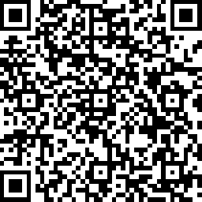
Please take a moment to respond
We are conducting an archdiocesan survey to understand the key pastoral topics for the Archdiocese.
Please take a few minutes to respond the Pastoral Priorities Survey, using this link or QR code:
https://es.surveymonkey.com/r/PastoralPriorities19
10 minutes
Notes:
Jim

Slide 13

Go and Talk to Strangers!
15 min

Slide 14
Contents
Introduction
7 Steps for Pastoral Planning
Pastoral Snapshot
Spirituality of Communion
10:20

Slide 15
How do we Know it is Working?
Technically,
Eucharist
Word
Worship
Community
Service
Evangelization
Leadership
Stewardship
Notes:
Jim

Slide 16
Test This out at Home
Revisit the Chapter 24 of Luke’s Gospel. (Lk 24, 1-53)
Identify the moments when resurrected Jesus teaches us about the Church’s work.
  Service
  Word
  Worship
  Community
What moment of the Emmaus Cycle is calling you personally? What is your parish being called to?
10 minutes
Notes:
Jim

Slide 17
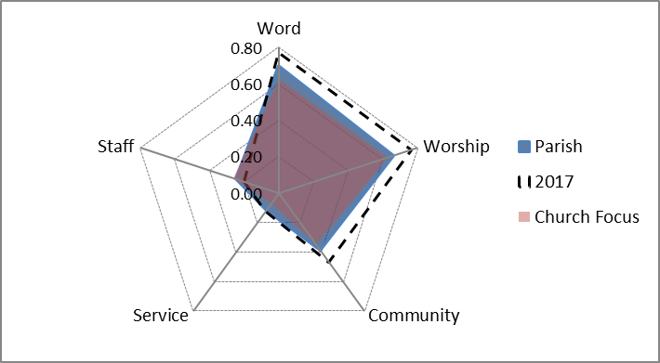
The Graph
Parish life Central Elements
Blue Polygon,
Most Recent Year
Pink Polygon,
Group of Reference
Dotted Line,
Previous Year
Notes:
Ricardo

Slide 18
Report Header
Archdiocesan percentiles on central parish life elements
Max value 1.000
Min value. 0.000
This parish is vibrant in Worship, its results are above 66% of the parishes, however they declined a bit.
This parish is not so vibrant in Service, they are less focused than the deanery and the Archdiocese.
This last measurement they lowered they Vibrancy:Staffing ratio.
Notes:
Ricardo

Slide 19
Word and Worship
For each variable the report displays its value and the archdiocesan percentile
Many values can also be analyzed as a proportion of registrants in the parish
Notes:
Ricardo

Slide 20
Community and Service
Notes:
Ricardo

Slide 21
Vibrancy: Similar Groups of Reference
Sprouts → Small, focused on Word and Worship.
Proclaimers → Mid-sized, solid Faith Formation.
Church Focused →Large, centered on the Sunday Eucharist.
Pious Mercy → Mid-sized, strong in Sacraments, reaching out.
Love my Community → Large, with balanced figures.
Silent Missionaries → Large communities, active in in organizations.
Rounding Up → Very large, active in every aspect.
Large Rounders → Super large, highly active celebrating marriages.
Notes:
Ricardo

Slide 22
Let us Analyze the Sample Parish
Use the Pastoral Snapshot for the sample parish you have.
Analyze its results individually
Discuss at your table.
  Which aspects of its parish life are more developed?
  Which aspects are least active?
  In your perspective, what should be their pastoral priority?
15 minutes
Notes:
Ricardo

Slide 23
Contents
Introduction
7 Steps for Pastoral Planning
Pastoral Snapshot
Spirituality of Communion
11:30

Slide 24

Spirituality of Communion
Spirituality of communion
The specific form on which the dynamic life of a community refracts the light of the Holy Spirit.
Insight
Process
Gift
Notes:
Ricardo

Slide 25
Understanding Spirituality of Communion
Please review the Spirituality of Communion handout.
Underline the most important phrases for you and discuss them at your table.
Go to mentimeter.com and use the code 21 03 52 for responding the second question.
What emotions would you say Spirituality of Communion generates in a group?
Group discussion.
10 minutes
Notes:
Ricardo

Slide 26
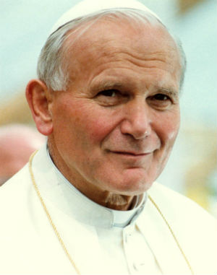
Novo Millennio Ineunte, 43
A spirituality of communion indicates above all the heart's contemplation of the mystery of the Trinity dwelling in us, and whose light we must also be able to see shining on the face of the brothers and sisters around us.
This makes us able to share their joys and sufferings, to sense their desires and attend to their needs, to offer them deep and genuine friendship, and bearing each other’s burdens.
Implies the ability to see what is positive in others, to welcome it and prize it as a gift from God: not only as a gift for the brother or sister who has received it directly, but also as a "gift for me".
Notes:
Jim

Slide 27
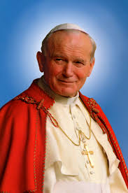
Communion Before Action
Our thoughts could run immediately to the action to be undertaken, but that would not be the right impulse to follow.
Spirituality of communion means resisting the selfish temptations which constantly beset us and provoke competition, careerism, distrust and jealousy.
Unless we follow this spiritual path, external structures of communion will serve very little purpose. They would become mechanisms without a soul, "masks" of communion rather than its means of expression and growth.
-St. John Paul II
Notes:
Jim

Slide 28
So, How do we Know we Know it is Working?
Spiritually,
Spirit
Joy
Peace
Patience
Kindness
Gener-osity
Faith-fulness
Gentle-ness
Self-control
Love
Evangelization
Leadership
Stewardship
Notes:
Jim- Ricardo

Slide 29

Prayer to the Holy Spirit
Holy Spirit of wisdom and understanding, enlighten our minds to perceive your voice and guidance in our daily work.
Spirit of right judgment and courage, guide us and make us firm in our baptismal decision to follow Jesus' way of love.
Spirit of knowledge and reverence, help us to see the lasting value of justice and mercy resulting from our initiatives.
May we build love and joy, as we work together to address the challenges of person, family, parish, nation, and Church.
Spirit of God, spark our faith, hope and love into our actions each day.
Fill our lives with wonder and awe in your presence, which penetrates all creation. Amen.
Notes:
Ricardo- Group

Slide 30

Thank you
See you next time!
Jim Barrette
713 741 8785
jbarrette@archgh.org
Ricardo Medina
281 512 8959
ricardo@factor-delta.com
Detailed tables, maps and demographic analysis are available at no cost to assist your parish with pastoral planning.
Tell us your interest, so we can schedule a meeting!

Slide 31
Workshop requirements
Required
Projector-Screen
Internet connection
Speakers
Microphone (large rooms)
Handouts:
  Reading John 15; 5-17 – Prayer
  7-Step Pastoral Planning process
  Sample Parish Pastoral Snapshot

